Slide 1

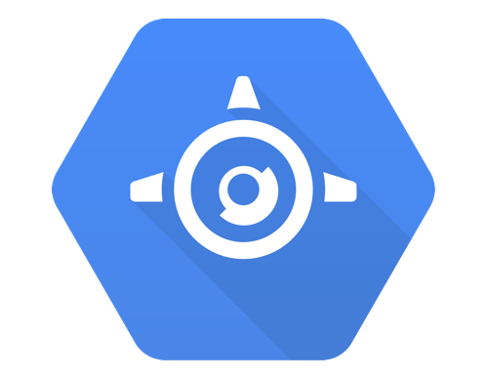

Databa$e$
Marco Acea
How to use Google Cloud Firestore

Slide 2
What is Firestore?
Firestore is one of the many features that Google Cloud offers for app development, and it is how developers store user information.
It programs users to store information, update it, and also run filters on it’s data.
You can also “listen” to your data and react to changes!

Slide 3
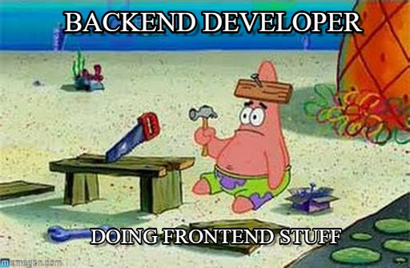
Getting Started
The first step is setting up a Google Cloud account
Go to https://console.cloud.google.com/
Complete your billing information (Don’t worry it’s not a subscription, it’s solely to make sure there is a name to the project)
Once that is done, set up your service account at this link
https://console.cloud.google.com/iam-admin/serviceaccounts
When asked what role you want, select Firebase Admin
Right before you finish setting this up save the key it offers as a JSON file
Then add that file to your folder

Slide 4
Getting Started Cont.
Now we can start by running the starter code, initially it will prompt you with two links because you haven't set up for database, it will look something like this:
Copy and paste the second link onto your browser and create your database, choose the native option when prompted.

Slide 5
Going through the starter code!
Now that we’ve finished setting things up, let’s step through some example code to get used to the things we can do with Firestore!
Things you need to know are: 1. How to read Python dictionaries and objects 2. Go back to step 1
Below I’ve linked my GitHub including starter files and the tutorial we’ll be going through!
https://github.com/aceamarco/Firestore-Tutorial

Slide 6
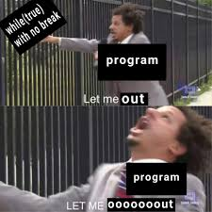
Moving Forward
If you have any questions feel free to send me an email, or ask to meet with me one-on-one, however give me some time to respond since it is TP season!
macea@andrew.cmu.edu
For more information on Firestore follow this link to Google’s documentation!
https://firebase.google.com/docs/firestore/quickstart

